Slide 1
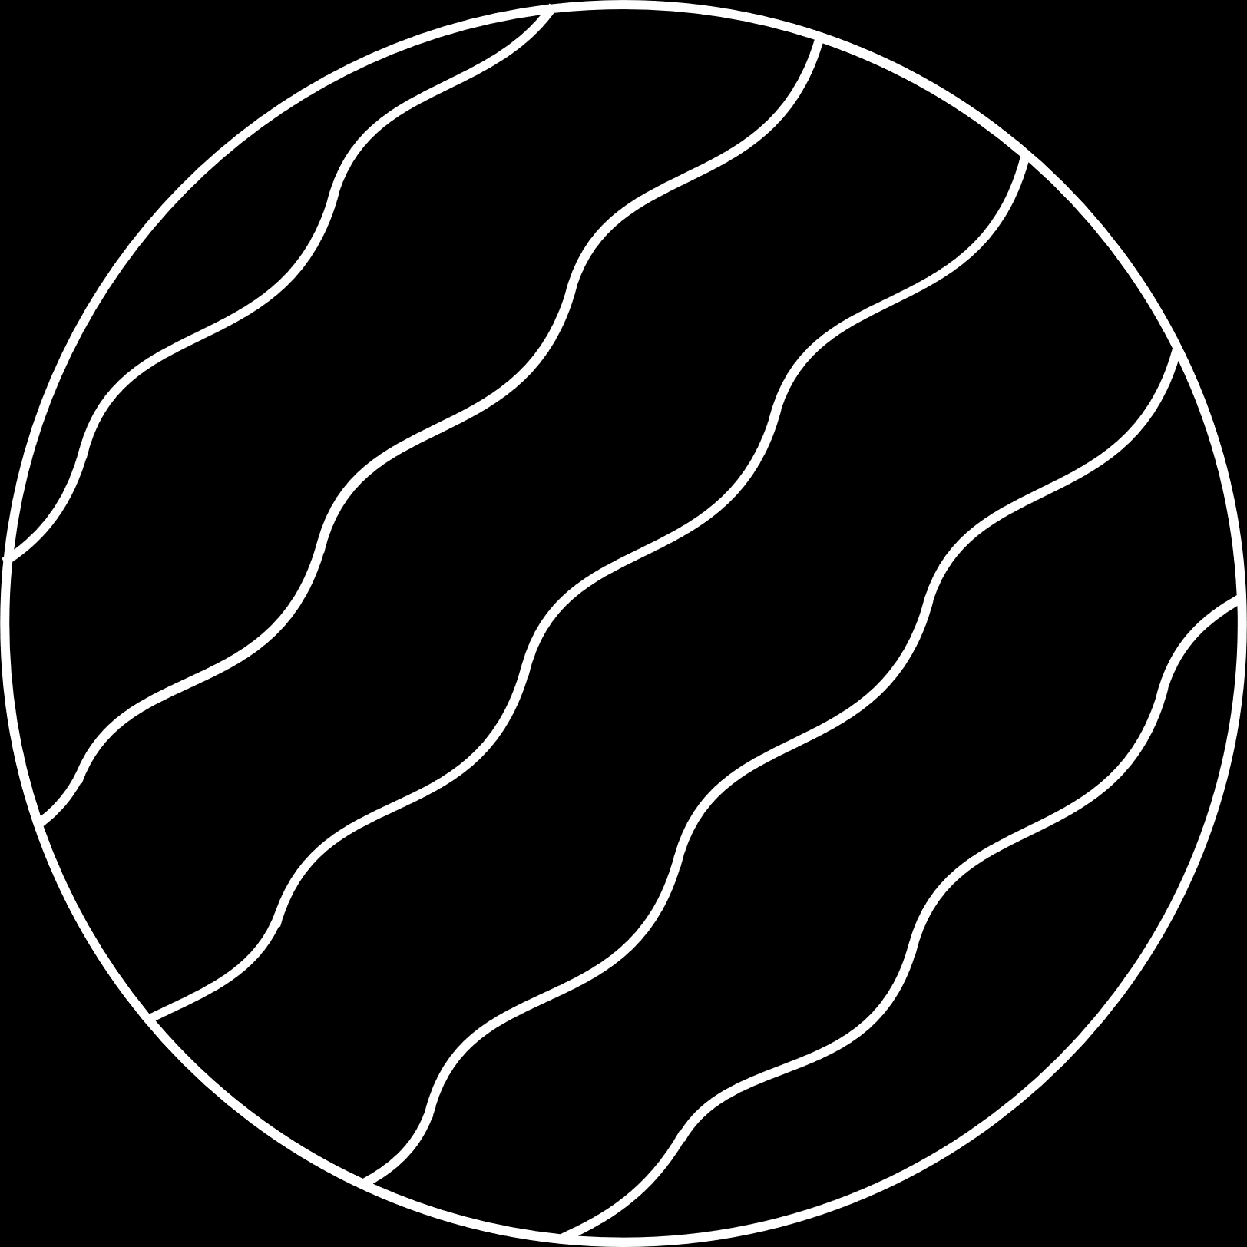

01
Movie Recommender
System
Ayush Meher 301224470
Machine Learning

Slide 2

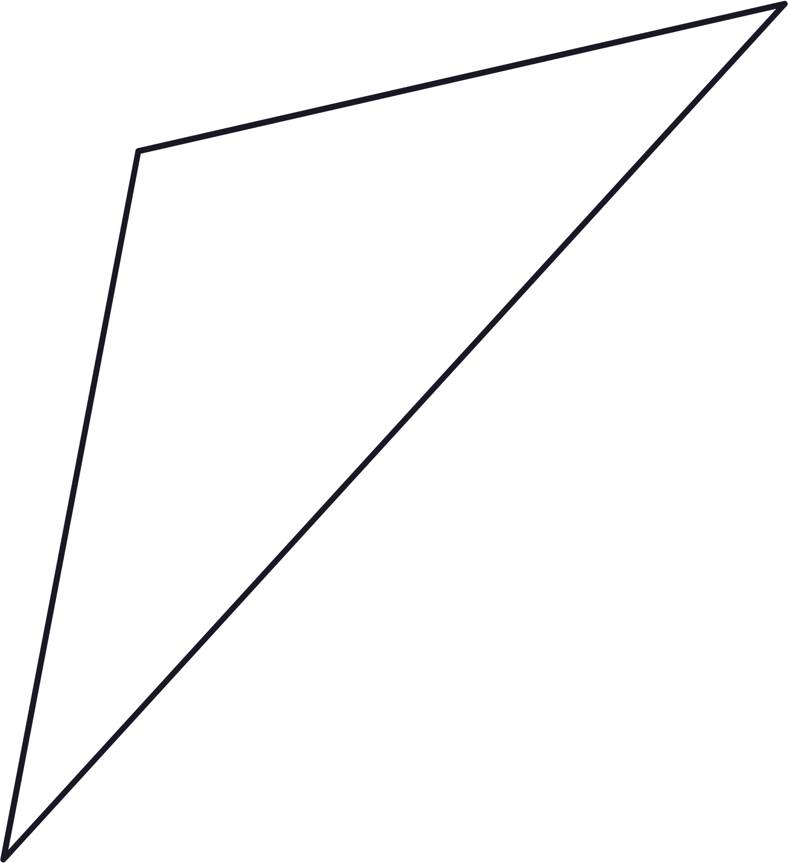

02
INTRODUCTION
Our project aims around building a movie recommendation system based on Collaborative filtering.
In particular we look at implementing three algorithms of item based collaborative filtering:
K-Nearest Neighbor's (KNN)
Singular value decomposition(SVD)
Alternating Least Squares (ALS).
This project uses movie-lens dataset which contains two files: movies.csv and rating.csv and has 9000 unique movies and 600 unique user . Total ratings in this dataset is around 300,000.

Slide 3

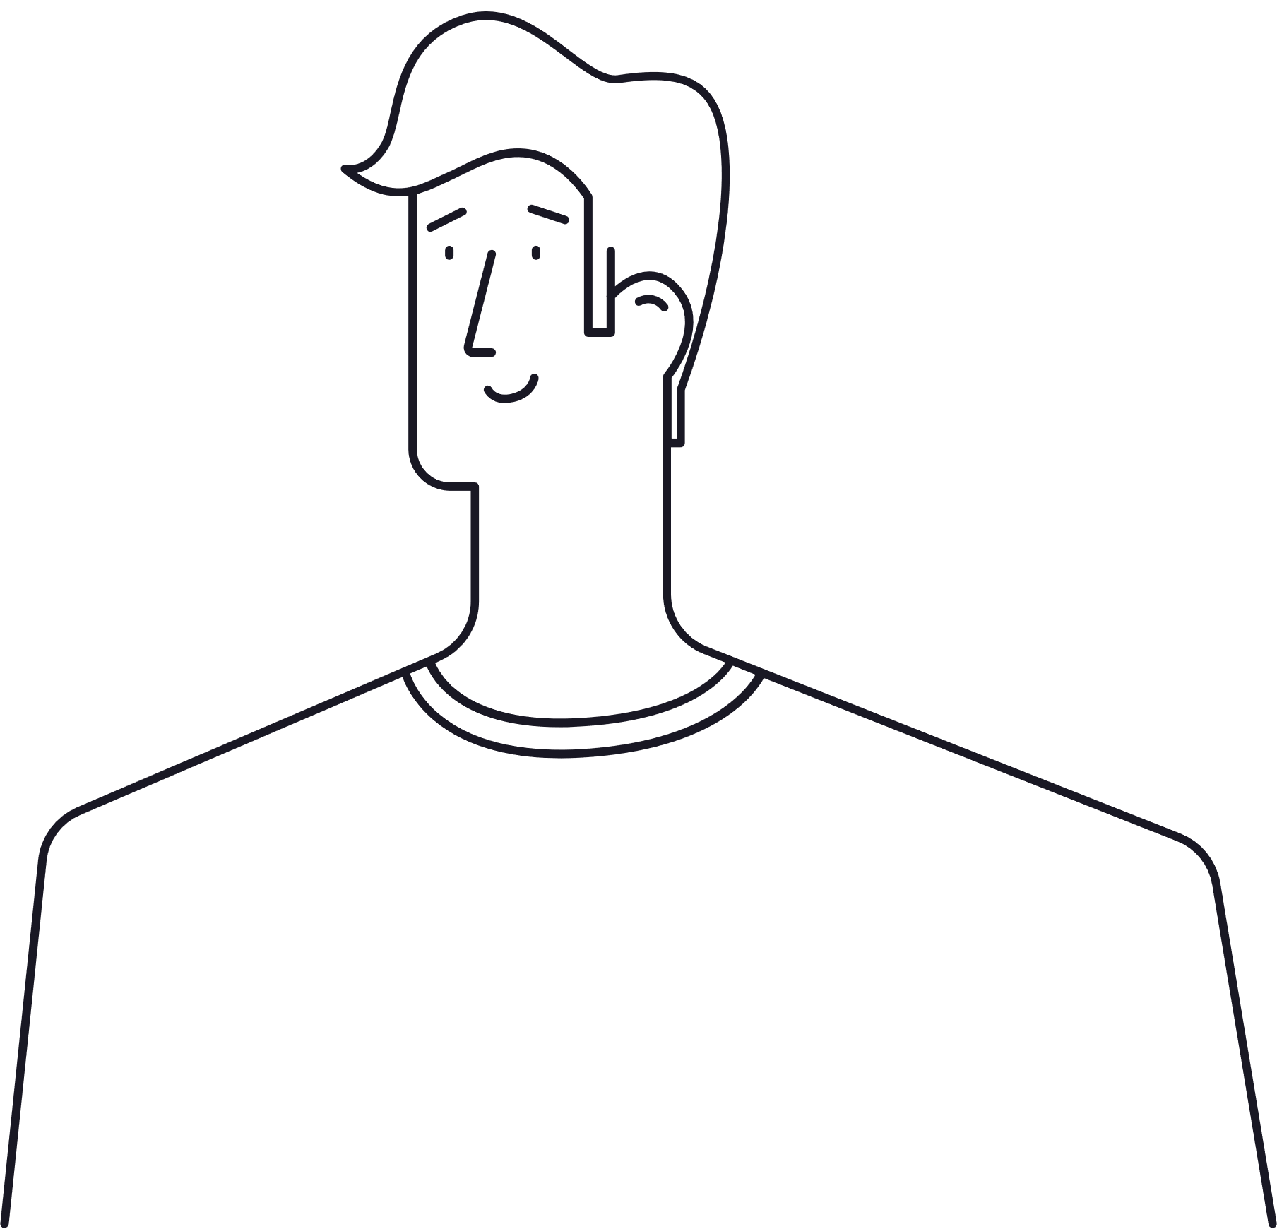
03
PROBLEM STATEMENT
Can we recommend a movie based on the users previous preference and rating ?
Can we recommend the movies based on given movie from the user ?
Given similar type of users can we recommend the movies rated by one user to the other similar users?
Can we recommend a movie, given there’s not enough data about the movie such as cast, release year, genres etc. ?
Can we compare different algorithms for recommender system?

Slide 4
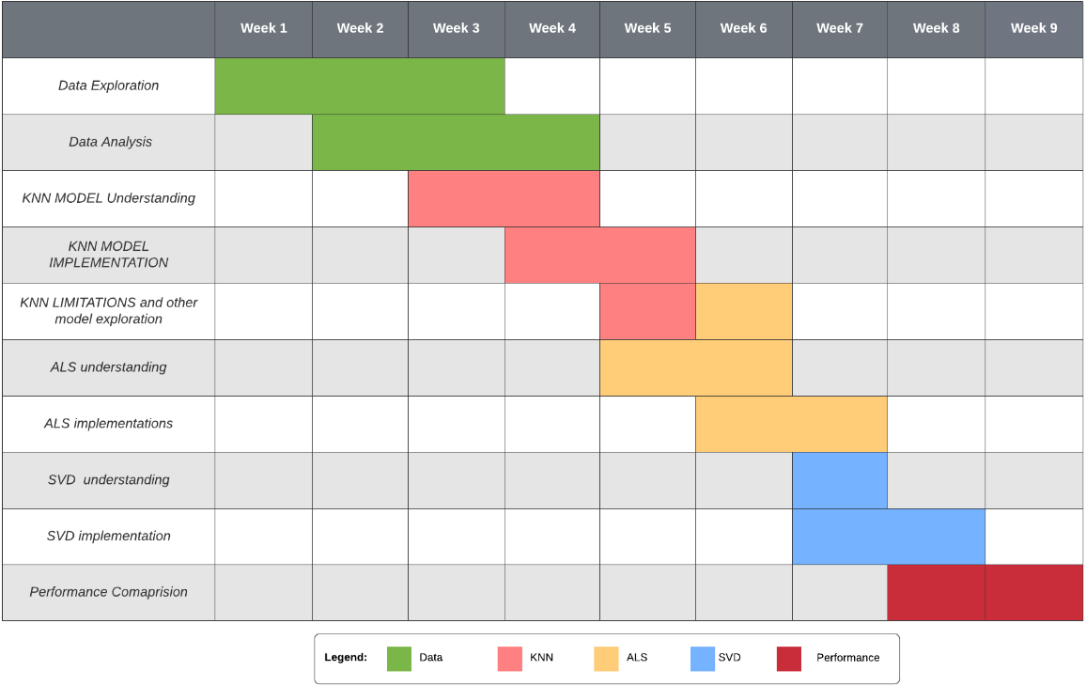
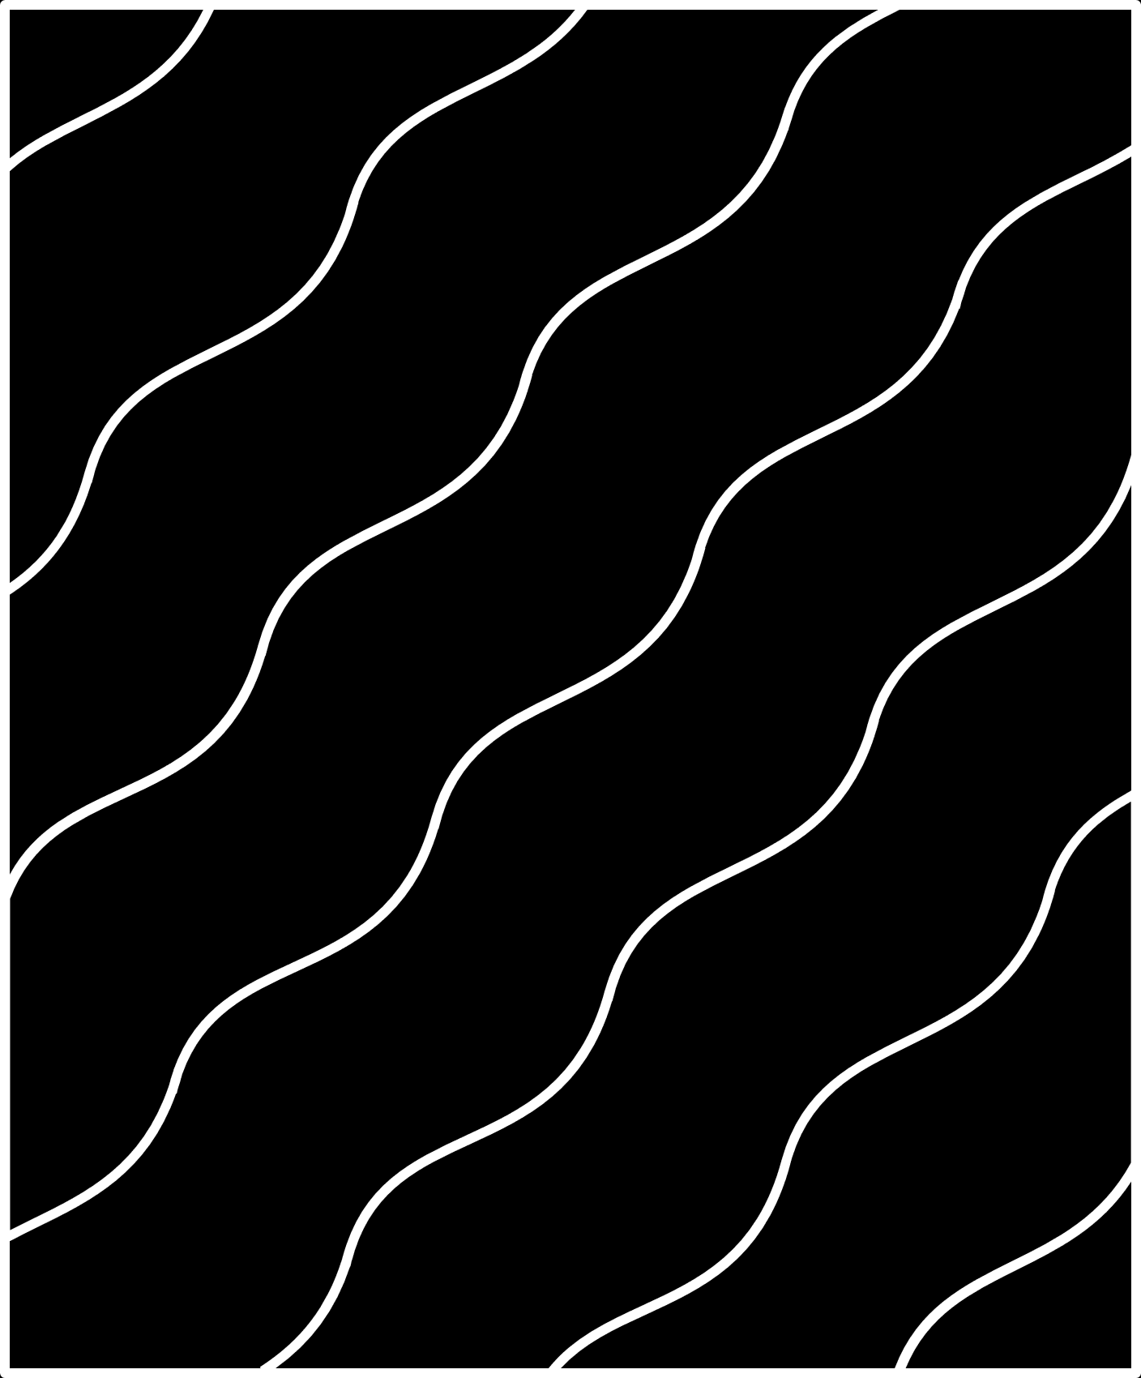

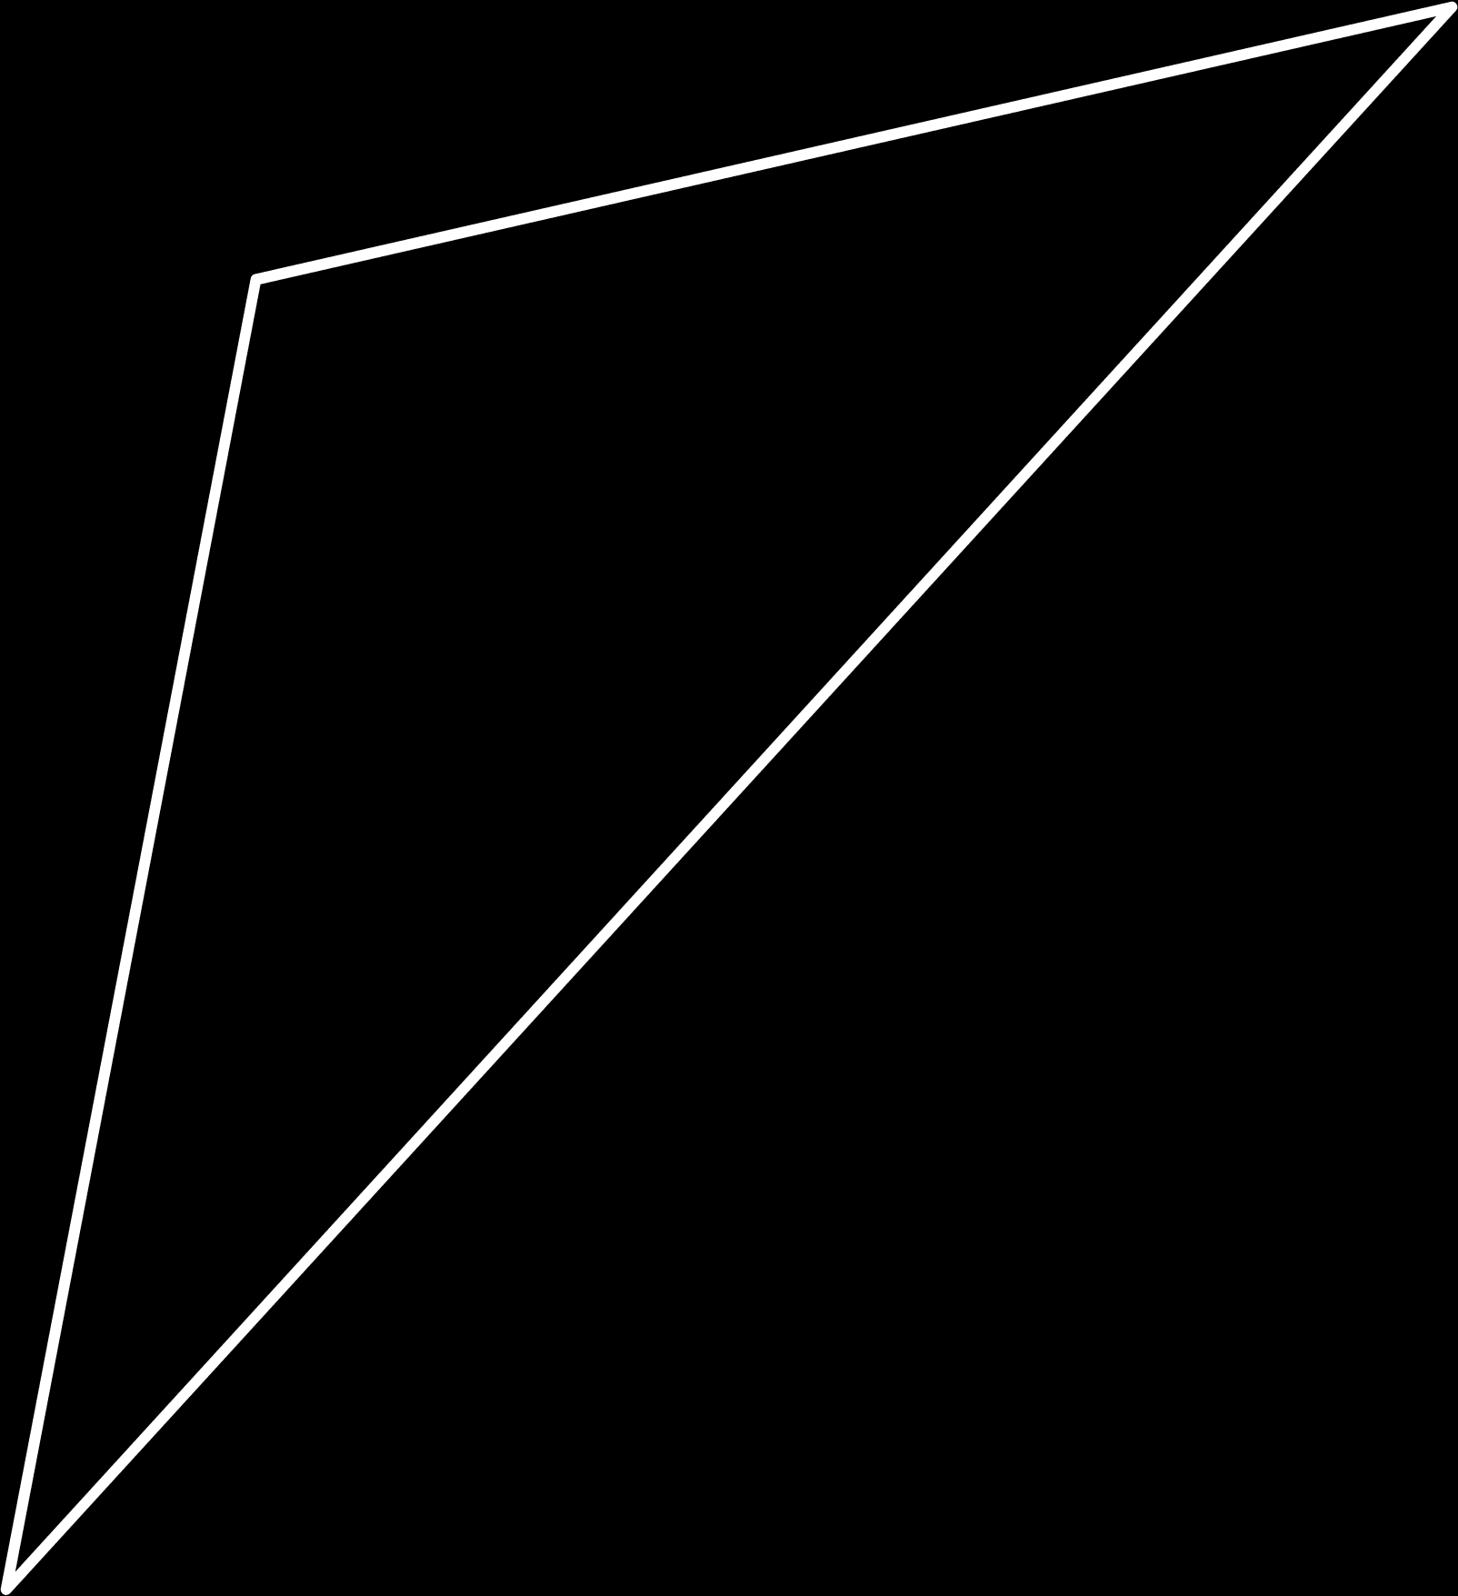
GHANTT CHART
04

Slide 5

05
EXISTING BODY OF WORK
Recommender System
Content-Based approach
Collaborative filtering
Hybrid models
It recommends other movies which are similar to that selected movie, in terms of features. Thus it needs a lot information about movie
f(movie) {movies}
It recommends other movies which are rated highly by similar users. Thus it finds similarity between users.
f(movie,user) {movies}
It uses both collaborative filtering and content-based approach.
It uses deep learning concept.

Slide 6
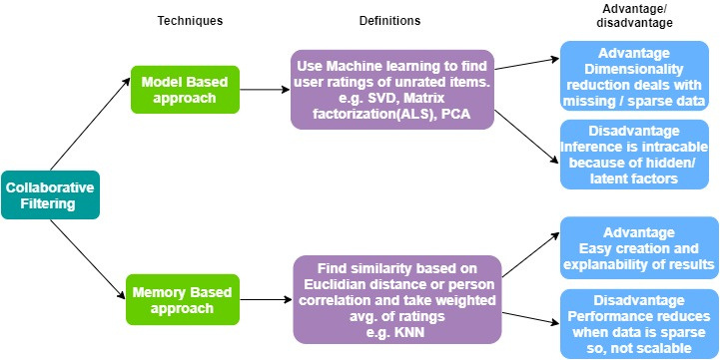
06

Slide 7
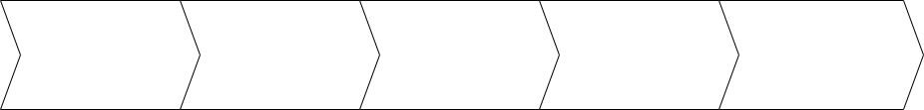






KNN
07
CLEAN AND RESHAPING THE DATA
Input MOVIE NAME
KNN MODEL
Calculating EUCLIDIAN DISTANCES
Recommending the K movies
Reduce the number of unwanted users and movies to decrease sparsity
Take the movie name from the user
selects movies from dataset which have a fuzz ratio of more than 50 for the given input
Euclidean distance for each selected movie with respect to the input movie and selects K nearest movies with the smallest Euclidean distance as per calculation.
Recommendeds top N movies from K nearest movies to the user.

Slide 8




08
LIMITATIONS OF KNN
Not Scalable
Popularity Bias
Cold Start problem
Lack of the ability to scale to much larger sets of data when more and more users and movies are added into our database.
A system recommending the movies with the most interactions without any personalization.
When movies added to the catalogue have either none or very little interactions while recommenders rely on the movie’s interactions to make recommendations.

Slide 9
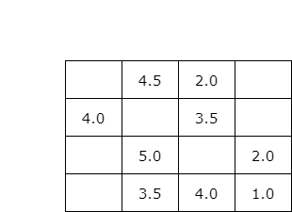

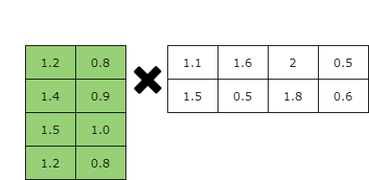

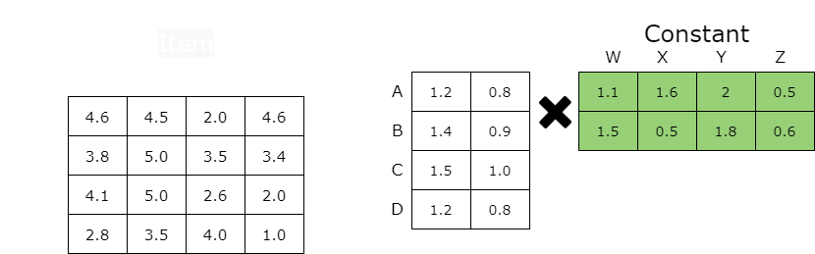
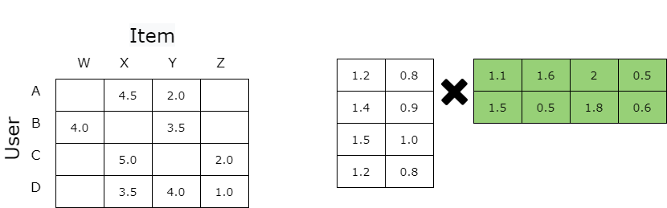
ALS
09
Step 4: Take a matrix constant and tune another matrix
Movie Data Set
Rating Matrix
Step 3: Decompose into lower dimension matrix
Step 1: Take the movie dateset
Step 2: Convert in into rating matrix
Run until
convergence
ITEM
Find product of two matrices to get predicted rating matrix
Predicted rating matrix
Step 5: Take the new updated matrix as constant and update other

Slide 10
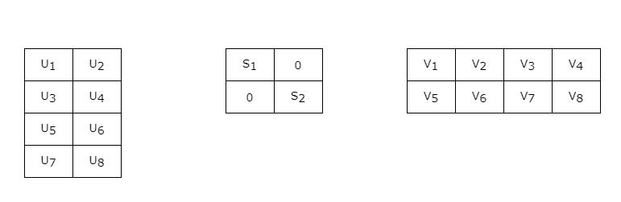

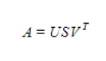
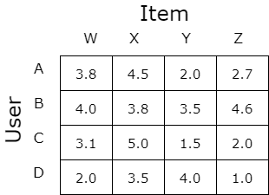

SVD
10
orthogonal left singular matrix
Movie Data Set
Step 1: Take the movie dateset
Step 2: Convert in into rating matrix
K is number of latent factors. Optimal value of K is selected by using RMSE values .
diagonal matrix
Step 3: Convert rating matrix into 3 lower dimensional matrix
Predicted Rating Matrix
Step 4: Calculate the product of 3 matrix
orthogonal right singular matrix

Slide 11

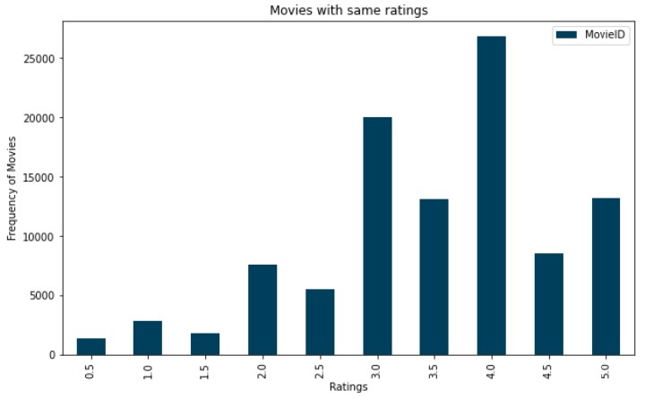
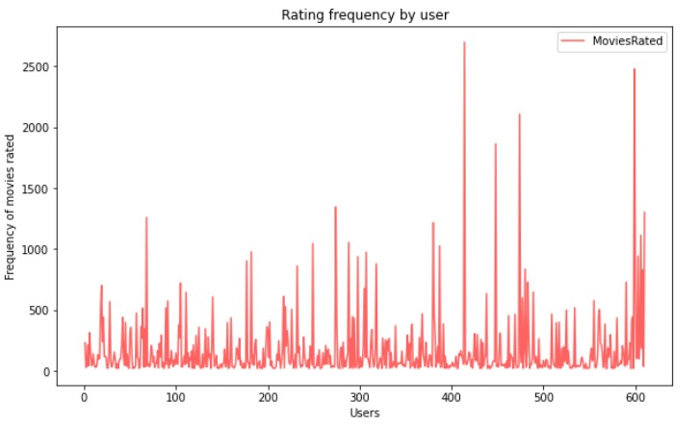
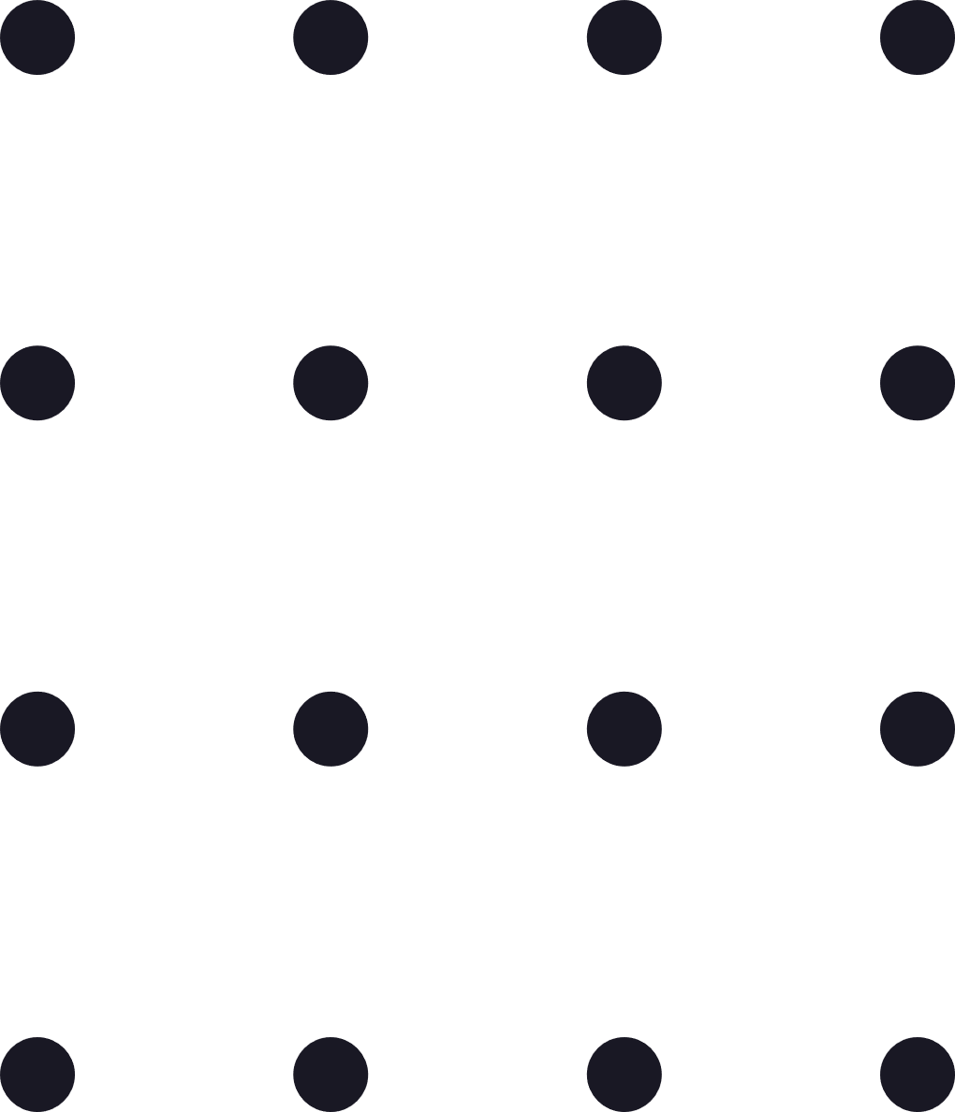
11
DATA ANALYSIS

Slide 12
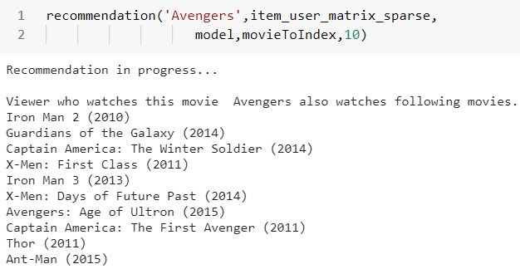
12
KNN RESULTS
08

Slide 13
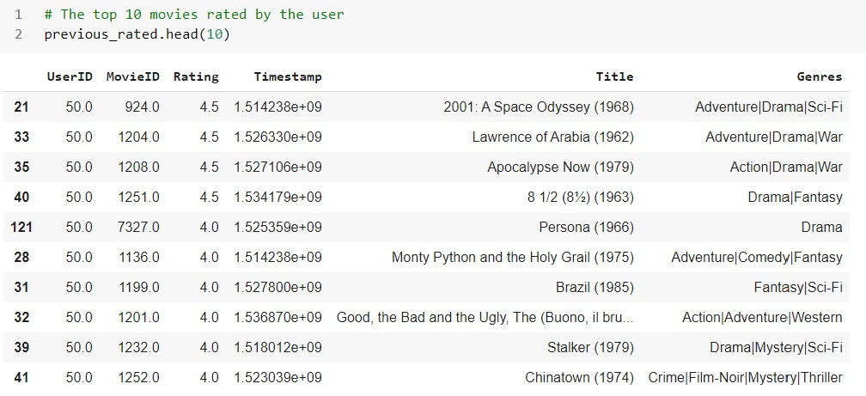
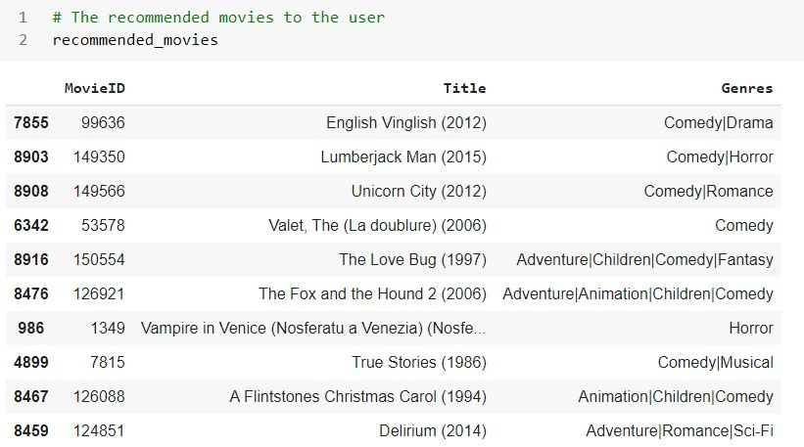
SVD RESULTS
13
07

Slide 14
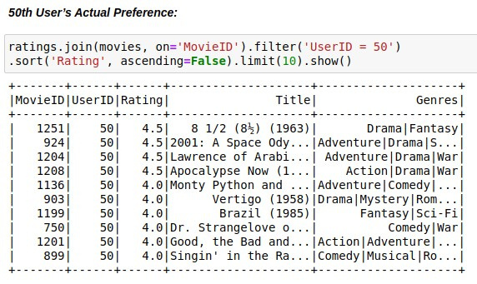
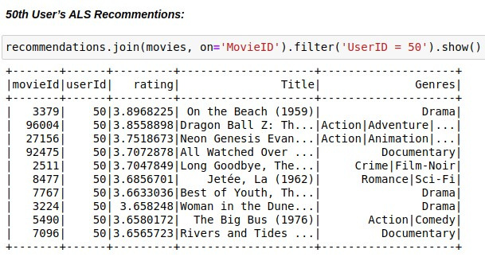
14
ALS RESULTS

Slide 15
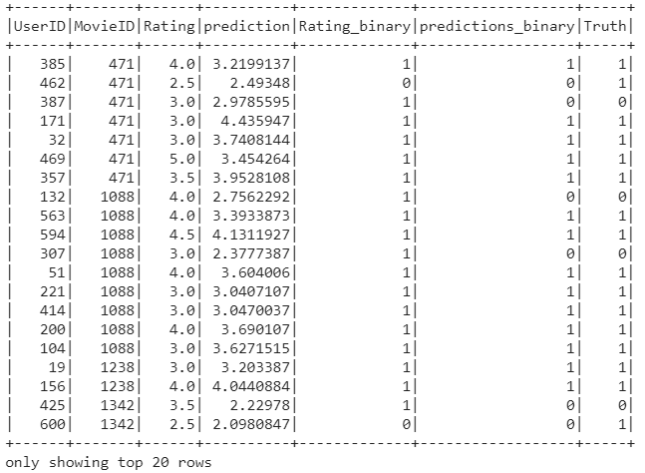
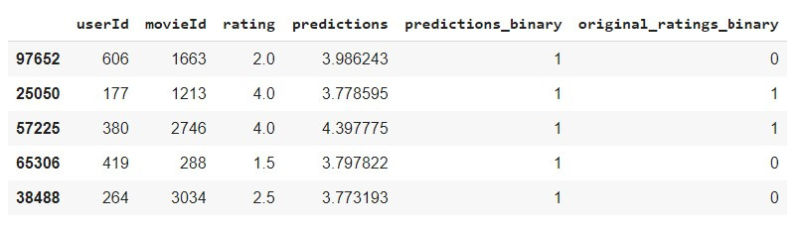
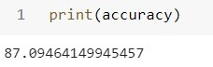
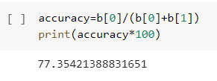
PERFORMNCE ANALYSIS
15
ALS
SVD

Slide 16
16
CONCLUSION
KNN algorithm is not precise for recommendation as it cannot deduce proper inference with large dimension labelled data, while ALS and SVD can overcome limitations of KNN.
From the performance analysis of SVD and KNN, we can say that in matrix factorization SVD performs better than ALS which implies that SVD performs the best of all three algorithms.

